Slide 1
10000 Reasons
Matt Redman
Bless the Lord Oh my soul, oh my soul Worship His holy name Sing like never before Oh my soul I’ll worship Your holy name

Slide 2
The sun comes up, it’s a new day dawning It’s time to sing Your song again Whatever may pass and whatever lies before me Let me be singing when the evening comes

Slide 3
Bless the Lord Oh my soul, oh my soul Worship His holy name Sing like never before Oh my soul I’ll worship Your holy name

Slide 4
You’re rich in love And You’re slow to anger Your name is great And Your heart is kind For all Your goodness I will keep on singing 10, 000 Reasons for my heart to find

Slide 5
Bless the Lord Oh my soul, oh my soul Worship His holy name Sing like never before Oh my soul I’ll worship Your holy name

Slide 6
And on that day when my strength is failing The end draws near and my time has come Still my soul will sing Your praise unending 10,000 Years and then forever more

Slide 7
Bless the Lord Oh my soul, oh my soul Worship His holy name Sing like never before Oh my soul I’ll worship Your holy name I’ll worship Your holy name I’ll worship Your holy name

Slide 9
Give Me Jesus
Jeremy Camp
In the morning, when I rise In the morning, when I rise In the morning, when I rise Give me Jesus

Slide 10
Give me Jesus, Give me Jesus. You can have all this world, Just give me Jesus

Slide 11
When I am alone, When I am alone, When I am alone, Give me Jesus

Slide 12
Give me Jesus, Give me Jesus. You can have all this world, Just give me Jesus
Jesus, give me Jesus

Slide 13
When I come to die, When I come to die, When I come to die, Give me Jesus

Slide 14
Give me Jesus, Give me Jesus. You can have all this world, You can have all this world, You can have all this world, Just give me Jesus

Slide 16
Psalm 46 Lord of Hosts
Jennie Lee Riddle | Josh Miller | Josiah Warneking | Shane Barnard
O come behold the works of God
The nations at His feet
He breaks the bow and bends the spear
And tells the wars to cease
O Mighty One of Israel You are on our side
We walk by faith
In God who burns the chariots with fire

Slide 17
Lord of hosts You’re with us with us in the fire
With us as a Shelter
With us in the storm
You will lead us
Through the fiercest battle
Oh where else would we go
But with the Lord of hosts

Slide 18
O God of Jacob fierce and great
You lift Your voice to speak
The earth it bows
And all the mountains move into the sea
O Lord You know the hearts of men
And still You let them live
O God who makes the mountains melt
Come wrestle us and win
O God who makes the mountains melt
Come wrestle us and win

Slide 19
Lord of hosts You’re with us with us in the fire
With us as a Shelter
With us in the storm
You will lead us
Through the fiercest battle
Oh where else would we go
But with the Lord of hosts

Slide 20
Though oceans roar You are the Lord of all
The One who calms the wind and waves
And makes my heart be still
Though the earth gives way
The mountains move into the sea
The nations rage
I know my God is in control

Slide 21
Lord of hosts You’re with us with us in the fire
With us as a Shelter
With us in the storm
You will lead us
Through the fiercest battle
Oh where else would we go
But with the Lord of hosts

Slide 23
Please ensure your child has used the restroom before leaving your child in Sunday school
Sunday School may be dismissed

Slide 25
SONS OF PROMISE LEARNING FROM THE JOURNEY OF ISAAC & JACOB GENESIS 25-36
Faith Bible Church | Farmington Hills

Slide 26
GENESIS 32:22-32
“THE STRUGGLING & THE BLESSING”

Slide 27
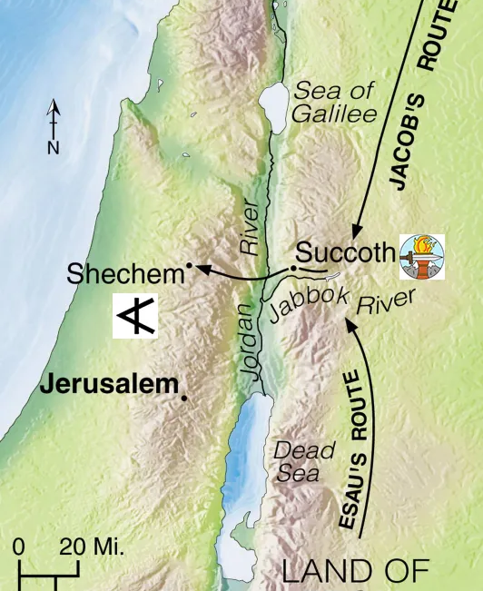
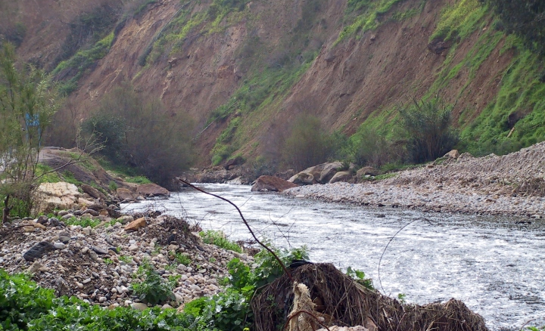
JABBOK RIVER

Slide 28
1. GOD’S PROMISED PRESENCE GRACIOUSLY MOVES YOU TO “TAP OUT” TO RECEIVE HIS BLESSING!

Slide 29
2. GOD’S PROMISED PRESENCE GRACIOUSLY MOVES YOU TO KEEP FIGHTING IN VICTORY!

Slide 30
WHEN YOU OWN YOUR WEAKNESS & TRUST IN HIS STRENGTH… VICTORY!

Slide 31
THROUGH THE LONG, DARK NIGHT OF OUR “FAITH STRUGGLES” IN THIS TWISTED WORLD – GRACIOUS BLESSINGS LEAD US ALL THE WAY HOME TO OUR FATHER’S HOUSE! HOLD ON IN FAITH!

Slide 33
Jesus Thank You
Pat Sczebel
The mystery of the cross I cannot comprehend, The agonies of Calvary. You, the Perfect Holy One, crushed Your Son, Drank the bitter cup reserved for me.

Slide 34
Your blood has washed away my sin, Jesus, thank You. The Father’s wrath completely satisfied, Jesus, thank You. Once Your enemy, now seated at Your table, Jesus, thank You.

Slide 35
By Your perfect sacrifice I’ve been brought near, Your enemy made Your friend. Pouring out the riches of Your glorious grace, Your mercy and your kindness know no end.

Slide 36
Your blood has washed away my sin, Jesus, thank You. The Father’s wrath completely satisfied, Jesus, thank You. Once Your enemy, now seated at Your table, Jesus, thank You.

Slide 37
Lover of my soul
I want to live for You
(repeat)

Slide 38
Your blood has washed away my sin, Jesus, thank You. The Father’s wrath completely satisfied, Jesus, thank You. Once Your enemy, now seated at Your table, Jesus, thank You.

Slide 39
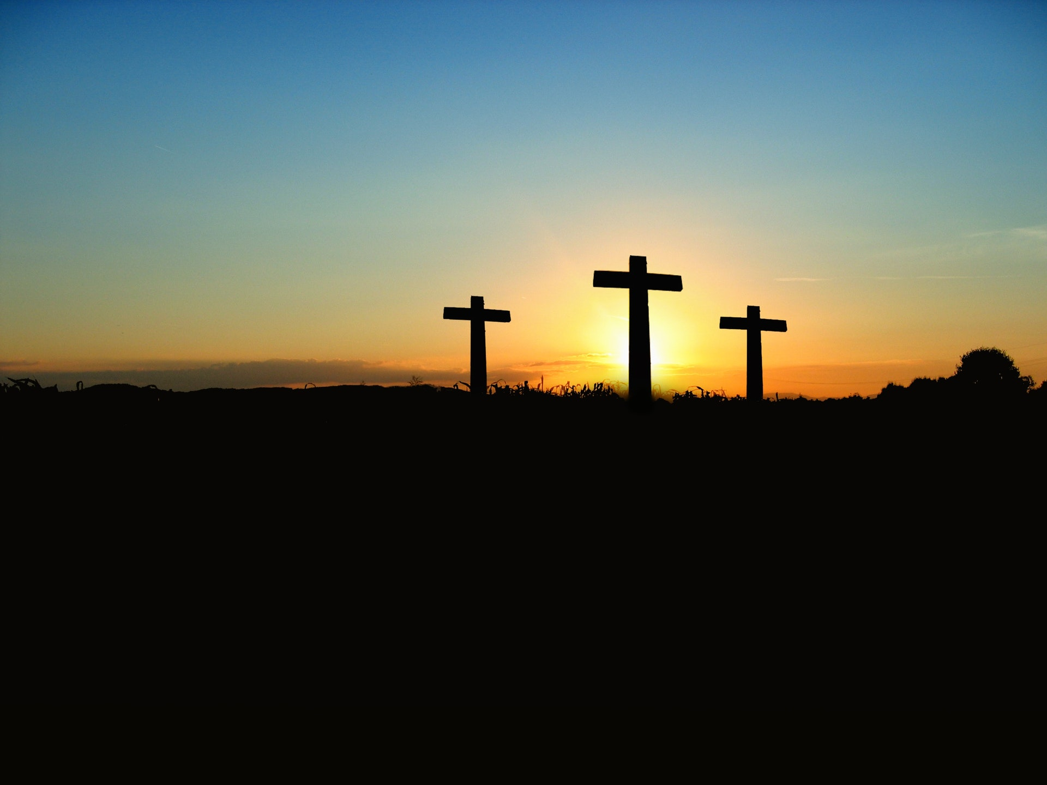
Lord’s Table
Let us celebrate the Lord’s Table

Slide 40
Overcome
Jon Egan
Seated above, enthroned in the Father's love Destined to die, poured out for all mankind God's only Son, perfect and spotless one He never sinned but suffered as if He did

Slide 41
All authority Every victory is Yours All authority Every victory is Yours

Slide 42
Savior, worthy of honor and glory Worthy of all our praise, You overcame Jesus, awesome in power forever Awesome and great is Your name, You overcame

Slide 43
Power in hand speaking the Father's plan You're sending us out, light in this broken land All authority Every victory is Yours

Slide 44
Savior, worthy of honor and glory Worthy of all our praise, You overcame Jesus, awesome in power forever Awesome and great is Your name, You overcame

Slide 45
We will overcome by the blood of the Lamb And the word of our testimony, everyone overcome
(Repeat)

Slide 46
Savior, worthy of honor and glory Worthy of all our praise, You overcame Jesus, awesome in power forever Awesome and great is Your name, You overcame

