Slide 1
SONS OF PROMISE LEARNING FROM THE JOURNEY OF ISAAC & JACOB GENESIS 25-36
Faith Bible Church | Farmington Hills

Slide 2
GENESIS 33:1-20
“GETTING BACK OUR BROTHER’S LOVE”

Slide 3
THE LORD IS SOVEREIGNLY WORKING HIS GRACIOUS WORK TO BRING ABOUT HIS PROMISED BLESSING!

Slide 4
1. THE GOD OF GLORY WORKS SURPRISE RECONCILIATION!

Slide 5
2. THE GOD OF GLORY DEMANDS OBEDIENT FOCUS!

Slide 6
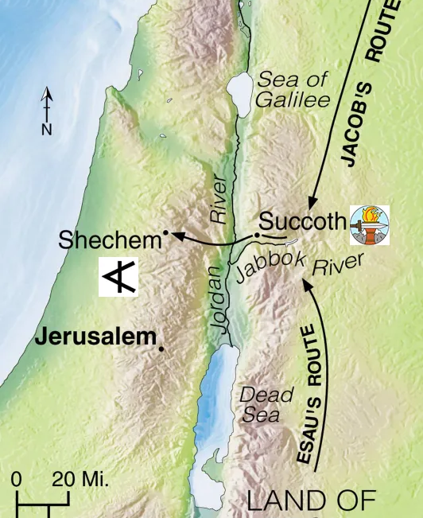
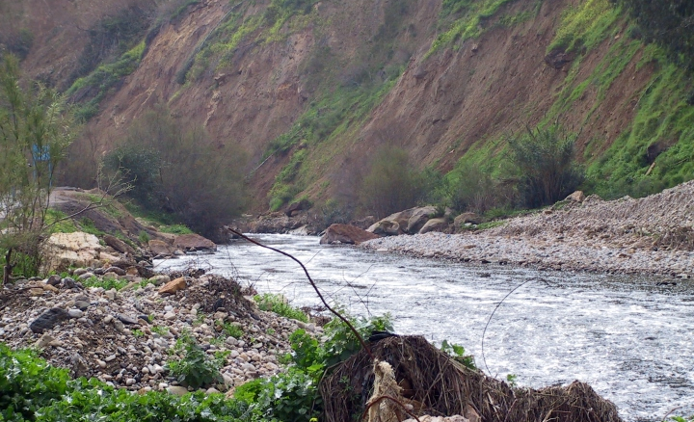
JABBOK RIVER

Slide 7
GOD’S GLORY DEMANDS OBEDIENT FOCUS – BY EVERYBODY! BUT WHEN WE LOSE THAT FOCUS – WE WILL RATIONALIZE SPIRITUAL COMPROMISE!

Slide 8
LET’S GET BACK TO OUR BROTHER’S LOVE!

Slide 9
For God, who said, “Let light shine out of darkness,” has shone in our hearts to give the light of the knowledge of the glory of God in the face of Jesus Christ. But we have this treasure in jars of clay, to show that the surpassing power belongs to God and not to us. (2 Corinthians 4:6-7)

