Slide 1
SONS OF PROMISE LEARNING FROM THE JOURNEY OF ISAAC & JACOB GENESIS 25-36
Faith Bible Church | Farmington Hills

Slide 2
GENESIS 34
“SIN’S CUTTING CONSEQUENCE &
THE HOPE FOR HEALING”

Slide 3
SIN MAKES LIFE A HOPELESS MESS – YET HOPE FOR THE HEALING YOU NEED IS FOUND IN THE PROMISE OF GOD’S PRESENCE.

Slide 4
WHAT DOES GOD WANT?

Slide 5
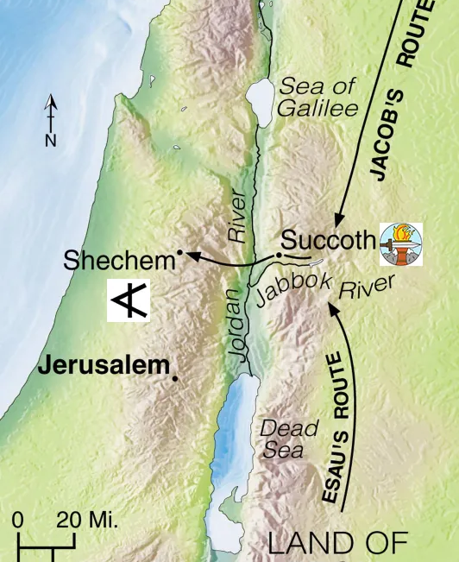
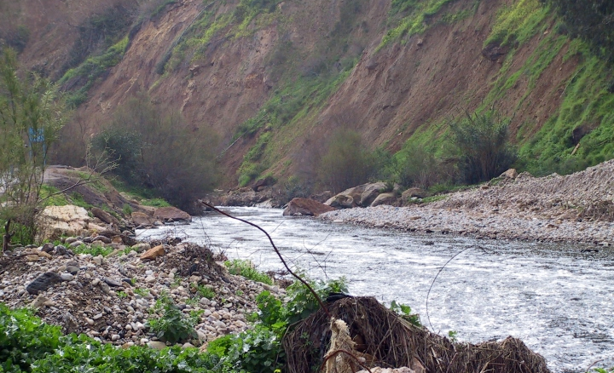
JABBOK RIVER

Slide 6
1. JACOB’S DAUGHTER GETS RAPED & THEN A PAGAN MARRIAGE PROPOSAL [GENESIS 34:1-7]

Slide 7
2. JACOB’S SONS MAKE A TREACHEROUS MARRIAGE ARRANGEMENT WITH THE PAGAN PRINCE. [GENESIS 34:8-25]

Slide 8
3. JACOB’S SONS TAKE GENOCIDAL REVENGE & RAISE A STINK. [GENESIS 34:26-31]

Slide 9
IN THIS SIN-CURSED, MESSY, BROKEN WORLD – HOLD ON TO GOD’S PROMISE OF BLESSING & DON’T STEAL GOD’S PREROGATIVE!

Slide 10
LET’S GET BACK TO OUR BROTHER’S LOVE!

Slide 11
For God, who said, “Let light shine out of darkness,” has shone in our hearts to give the light of the knowledge of the glory of God in the face of Jesus Christ. But we have this treasure in jars of clay, to show that the surpassing power belongs to God and not to us. (2 Corinthians 4:6-7)

