Slide 1
FEBRUARY 11, 2024

Slide 2
“THE MARRIAGE BEDROOM”
In Search of Intimacy

Slide 3
in·ti·ma·cy = the state of being intimate...a close, familiar, and usually affectionate or loving personal relationship with another person or group...a close association with or detailed knowledge or deep understanding of a person, place, or thing.

Slide 4
THE FOUNDATION OF INTIMACY:
God’s Gift of Love!

Slide 5
Beloved, let us love one another, for love is from God,
and whoever loves has been born of God and knows God.
Anyone who does not love does not know God,
because God is love.
In this the love of God was made manifest among us,
that God sent his only Son into the world,
so that we might live through him.
(1 John 4:7-9)

Slide 6
Real love is a commitment to sacrificially give yourself
for the highest good of the other!

Slide 7
CONSUMER RELATIONSHIP or COVENANT RELATIONSHIP?

Slide 8
The covenant in marriage and God’s covenant to us in Jesus Christ are meant to explain each other.
This is Paul’s point in Ephesians 5:22-33…

Slide 9
Ephesians 5,
22 Wives, submit to your own husbands, as to the Lord. 23 For the husband is the head of the wife even as Christ is the head of the church, his body, and is himself its Savior. 24 Now as the church submits to Christ, so also wives should submit in everything to their husbands. 25 Husbands, love your wives, as Christ loved the church and gave himself up for her, 26 that he might sanctify her, having cleansed her by the washing of water with the word,
27 so that he might present the church to himself in splendor,
without spot or wrinkle or any such thing,
that she might be holy and without blemish.

Slide 10
Ephesians 5,
28 In the same way husbands should love their wives as their own bodies. He who loves his wife loves himself. 29 For no one ever hated his own flesh, but nourishes and cherishes it, just as Christ does the church, 30 because we are members of his body. 31 “Therefore a man shall leave his father and mother and hold fast to his wife, and the two shall become one flesh.” 32 This mystery is profound, and I am saying that it refers to Christ and the church. 33 However, let each one of you love his wife as himself, and let the wife see that she respects her husband.”

Slide 11
CONSUMER RELATIONSHIP = Velcro COVENANT RELATIONSHIP = Super Glue

Slide 12
Intimacy in the marriage covenant comes from a promise of future commitment.

Slide 13
EMOTIONAL INTIMACY

Slide 14
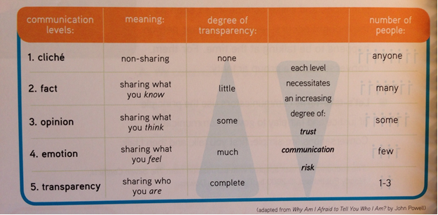

Slide 15
“I am my beloved’s and my beloved is mine!” Song of Solomon 6:3

Slide 16
PHYSICAL INTIMACY

Slide 17
“Don’t deprive one another, except perhaps by agreement for a limited time, that you may devote yourselves to prayer; but then come together again, so that Satan may not tempt you because of your lack of self-control.” (1 Corinthians 7:5)

Slide 18
“Let marriage be held in honor among all, and let the marriage bed be undefiled, for God will judge the sexually immoral and adulterous.” (Hebrews 13:4)

Slide 19
“May your fountain be blessed, and may you rejoice in the wife of your youth. A loving doe, a graceful deer— may her breasts satisfy you always, may you ever be intoxicated with her love.” Proverbs 5:18-19

Slide 20
SPIRITUAL INTIMACY

Slide 22
Foundation on the Rock? Matthew 7:24-27…

